Slide 1
Efficient Poverty Mapping from High Resolution Remote Sensing Images
Kumar Ayush^{*1}, Burak Uzkent^{*1}, Kumar Tanmay³, Marshall Burke², David Lobell², Stefano Ermon¹
¹Department of Computer Science, Stanford University
²Department of Earth System Science, Stanford University
³Department of Electrical Engineering, IIT Kharagpur
Notes:
Hello everyone, we are pleased to present our work on ‘Efficient Poverty Mapping from High Resolution Remote Sensing Images’.

Slide 2

Motivation
#1 UN Sustainable Development Goal:
Global Poverty Line : $1.90 per person for one day.
Understanding poverty can lead to:
Informed policy making
Targeted NGO and aid efforts.
Notes:
Accurate measurements of poverty and related human livelihood outcomes critically shape the decisions of governments and humanitarian organizations around the world, and the eradication of poverty remains the first of the United Nations Sustainable Development Goals

Slide 3
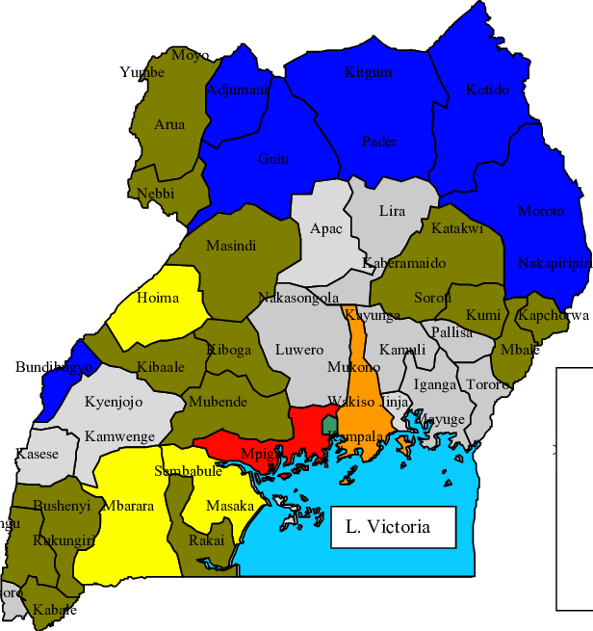
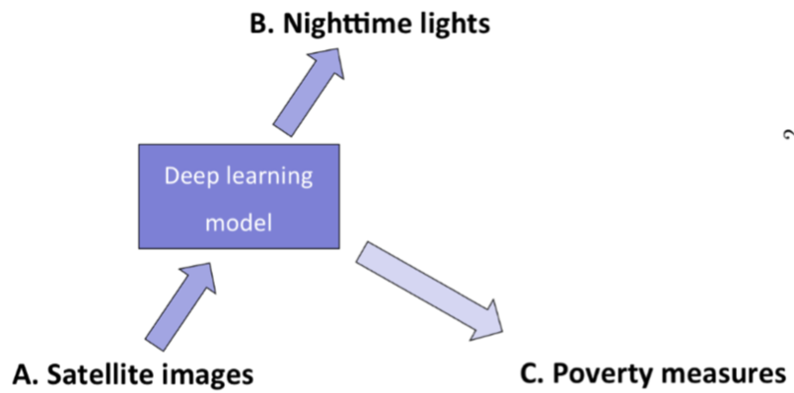
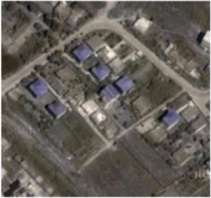
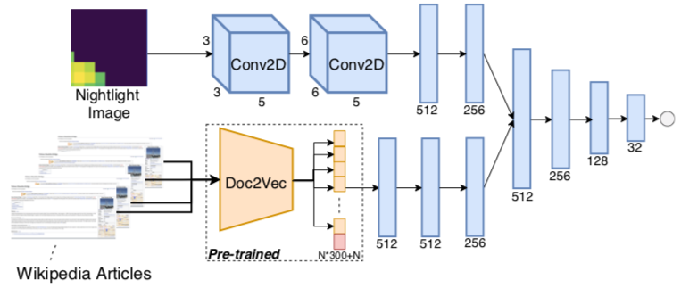
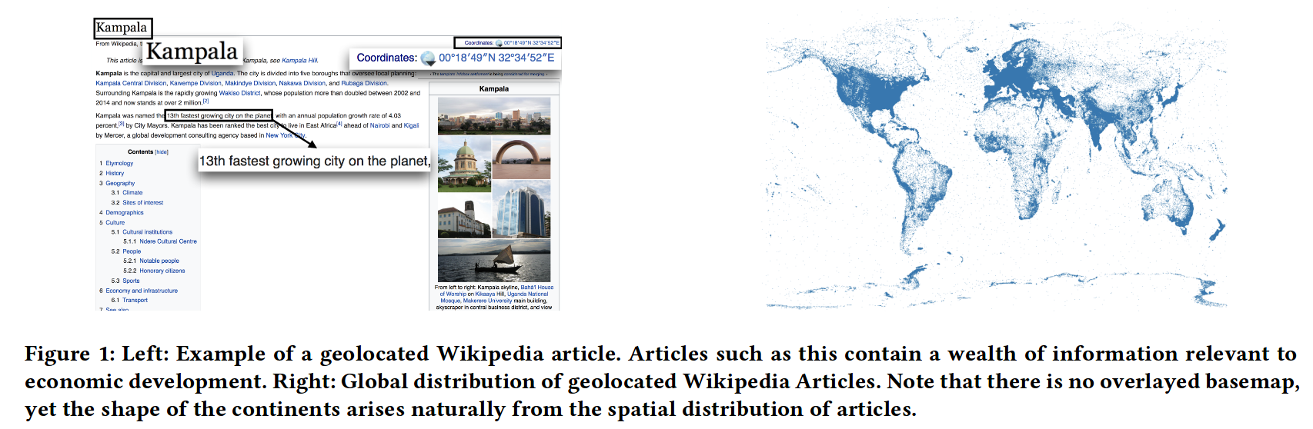
Introduction
Uganda
*However, all the studies lack interpretability as they mostly focus on predictive performance.
Representation
(Satellite, Nightlight Images, Wikipedia etc.)
Build a Machine Learning Model
Satellite
Nightlight
Wikipedia Article
*Interpretability can be very helpful for targeted policy making to tackle poverty.
Notes:
There have been numerous attempts towards accurate measurement of poverty through the combination of machine learning with cheap, globally available data streams such as remotely sensed data like satellite images or nightlight images and wikipedia articles.
However, these studies lack interpretability. Interpretability of model predictions is key for whether policymakers will adopt machine-learning based approaches to livelihoods measurement, and current approaches attempt to maximize predictive performance rather than interpretability.

Slide 4
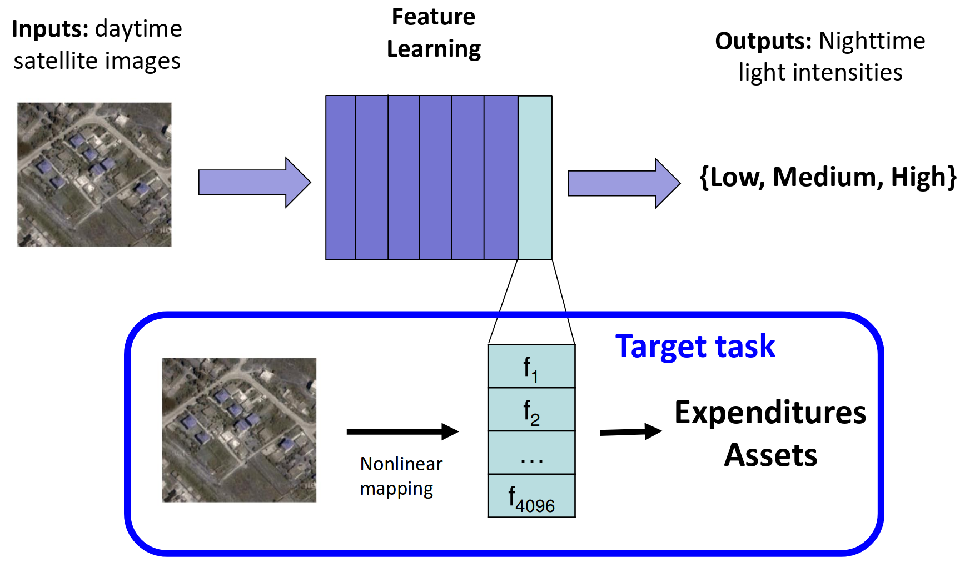
Related Work
Jean et al. (Science 2016)
*Not easy to interpret
Notes:
Jean et al. train a CNN to extract features in high-resolution daytime images using low-resolution nighttime images as labels, and then use the extracted features to predict asset wealth and consumption expenditure across five African countries. However, these features are not easy to interpret.

Slide 5
Related Work
Sheehan & Ming et al. (KDD 2019)
Notes:
Sheehan and Meng et al. propose a novel method for estimating socioeconomic indicators using open-source, geolocated textual information from Wikipedia articles.

Slide 6
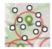
Related Work
Sheehan & Ming et al. (KDD 2019)
*Not easy to interpret
Notes:
They demonstrate that modern NLP techniques can be used to predict community level asset wealth and education outcomes using nearby geolocated Wikipedia articles. When paired with nightlights satellite imagery, their method provides reasonably accurate predictions.
However, this method is also not interpretable. There are numerous follow up works but none focus on interpretability.

Slide 7
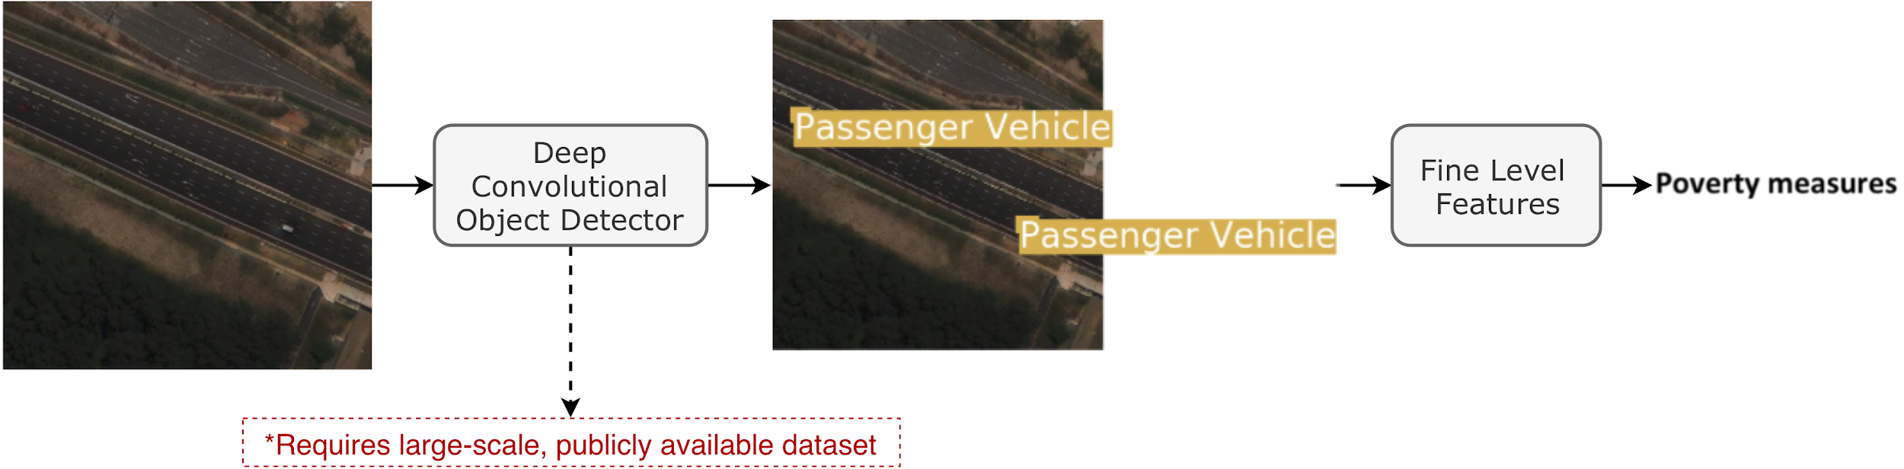
Solution - Object Detection for Interpretability
Ayush et al. (IJCAI 2020)
*Represent satellite images with fine level, interpretable features.
# of trucks
# of cars
# of planes
-
-
We can find out the correlation between number of certain objects and poverty index as:
High number of trucks are correlated with low poverty.
High number of settlements are correlated with high poverty.
Notes:
In our previous work published at IJCAI 2020, we make use of high-resolution satellite imagery to obtain fine level interpretable features via object detection for poverty measurement.
Such an approach can be used to find out the correlation between number of certain objects and poverty index like:
High number of trucks are correlated with low poverty.
High number of settlements are correlated with high poverty.
Our work is built upon this previous work of ours. Therefore, we will give an overview of our previous work and then discuss our AAAI paper.
As you can see, we need to train a good object detector for our task which requires a large-scale, publicly available dataset.

Slide 8
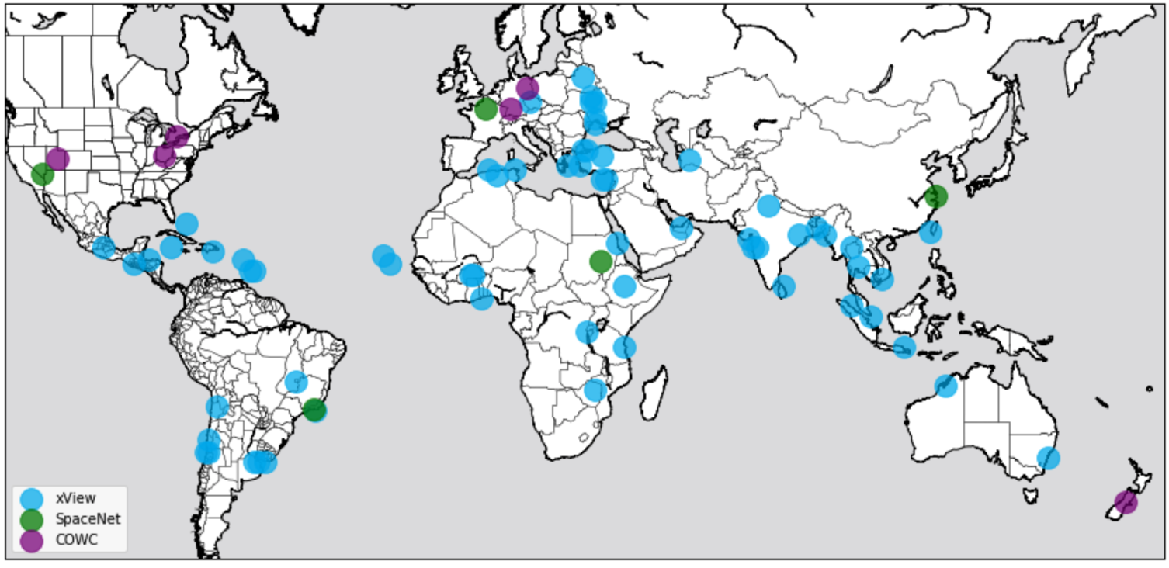
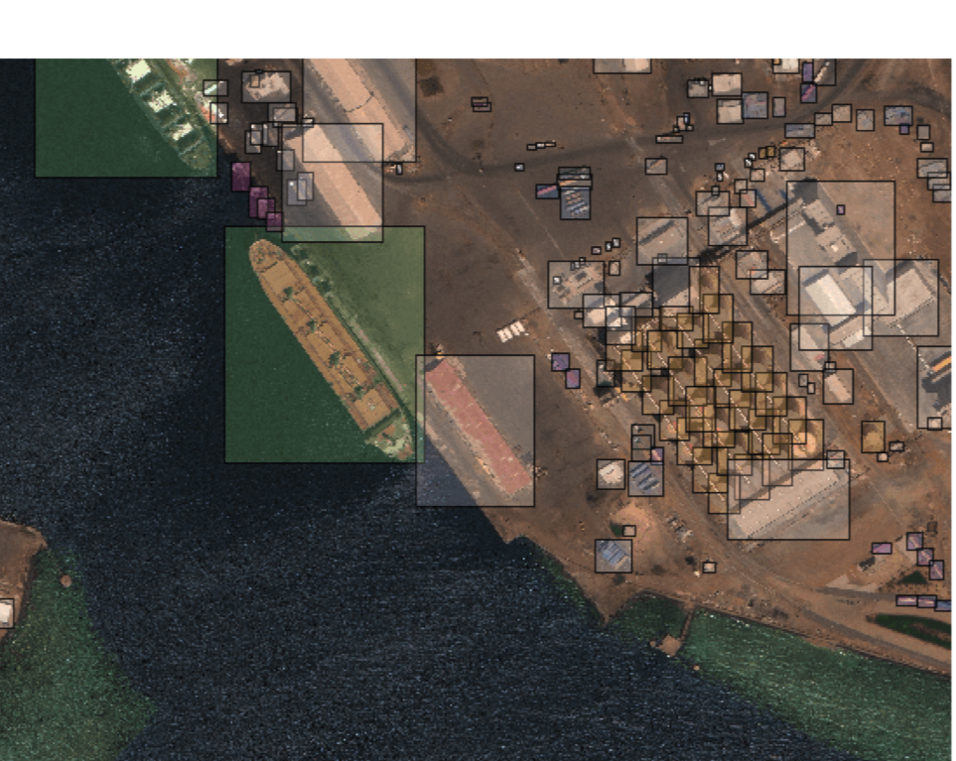
xView - A Large Scale Dataset
Up until 2018, there was no large scale global object detection dataset from satellite images.
Lam et al. (NeurIPS 2018-xView)
Notes:
Up until recently, there was no large scale global object detection dataset from satellite images.
Lam et al released xView which we use to train the object detector. It is one of the largest and most diverse publicly available overhead imagery datasets for object detection. It covers over 1, 400 km2 of the earth’s surface, with 60 classes and approximately 1 million labeled objects. The satellite images are collected from DigitalGlobe satellites at 0.3 m Ground Sampling Distance.

Slide 9
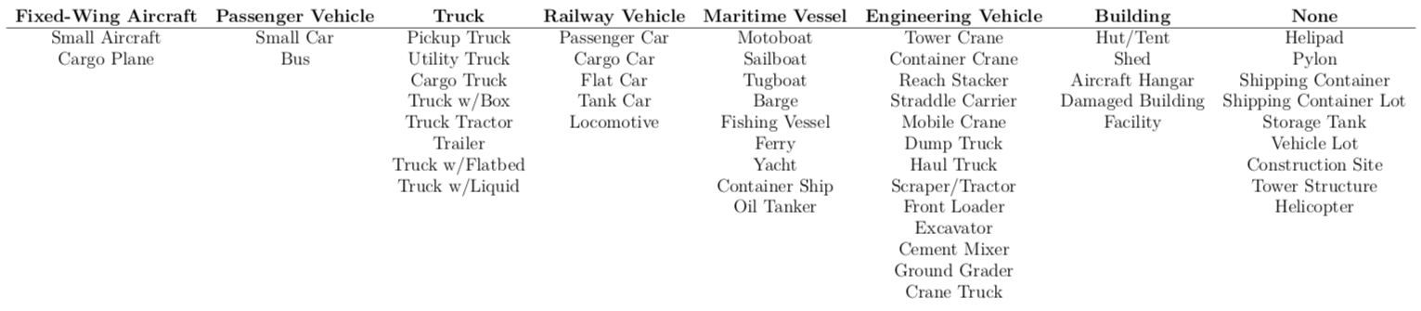
xView - Class Hierarchy
Parent
Child
Ayush et al. (IJCAI 2020) use two different set of classes:
Child level classes - can be helpful to integrate richer set of features.
Parent level classes - can be helpful for increased detector accuracy since classification task becomes easier.
Notes:
This slide shows the class hierarchy in xVIew. The child classes are more specific than their parents. Overall, there are 60 child classes and 10 parent classes.
Ayush et al use the two different set of classes for our task of poverty measurement. Here Child classes can be helpful to integrate richer set of features and parent classed can be helpful for increased detector accuracy since classification task becomes easier.
In our AAAI paper we only focus on parent level classes.
Trade-off between object detector accuracy and amount of information.

Slide 10
Training Object Detector on xView
xView consists of 846 very large satellite images (roughly 4000 x 4000 pixels).
Due to computational constraints, it is impossible to process such large images in one shot with convolutional detectors.
For this reason, we crop smaller areas (416 x 416 pixels) from large images randomly, giving us 36k crops across 846 large images.
We then use 30k crops from 700 large images and 6k crops from 146 very large images for training and test set.
Finally, we train YOLO-v3 with a DarkNet53 backbone on our training set.
Notes:
Next we discuss training object detector on xview.
YOLOv3 outperforms other single stage detectors and performs almost on par with RetinaNet but 3.8 × faster on small objects while running significantly faster than two-stage detectors.
Since we work on very large tiles (∼3000×3000 pixels), we only consider single stage detectors. Considering the trade off between run-time performance and accuracy on small objects, YOLOv3 outperforms other single stage detectors and performs almost on par with RetinaNet but 3.8 × faster on small objects while running significantly faster than two-stage detectors. Therefore, we use YOLOv3 object detector with a DarkNet53 backbone architecture.

Slide 11
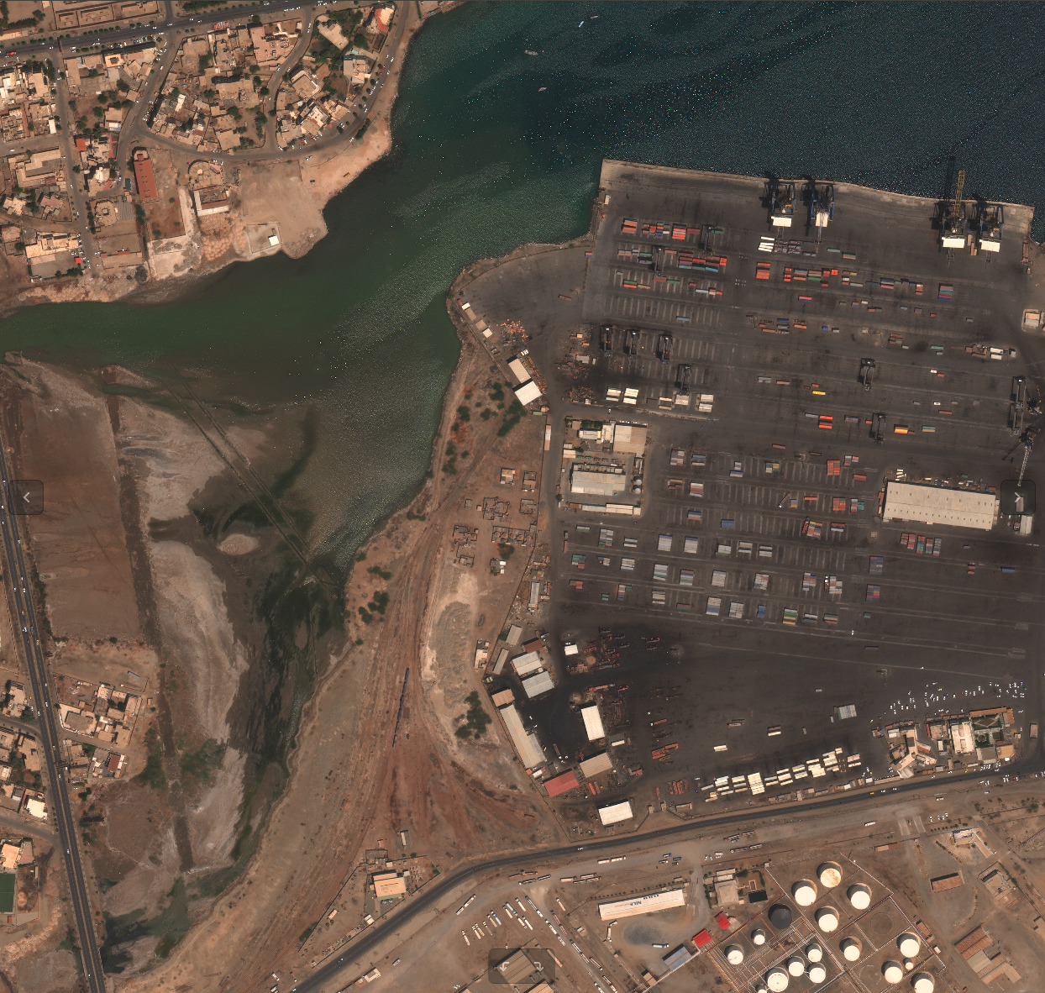
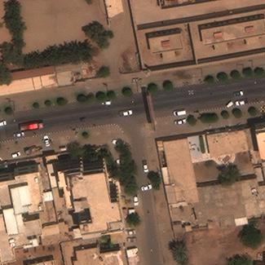
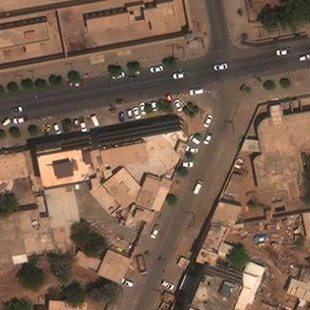
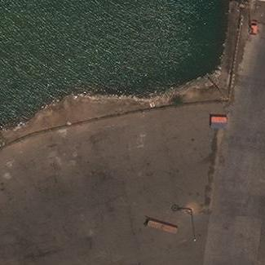
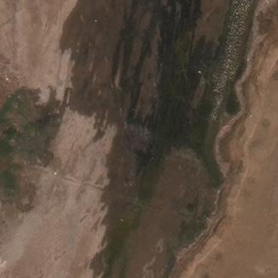
Training YOLOv3
5000
416
416
5000
*Choose 80% of the 846 images randomly for training.
Chips
Notes:
Here we visually show the 416x416 px chips from large xView images that we use for training the object detector.

Slide 12
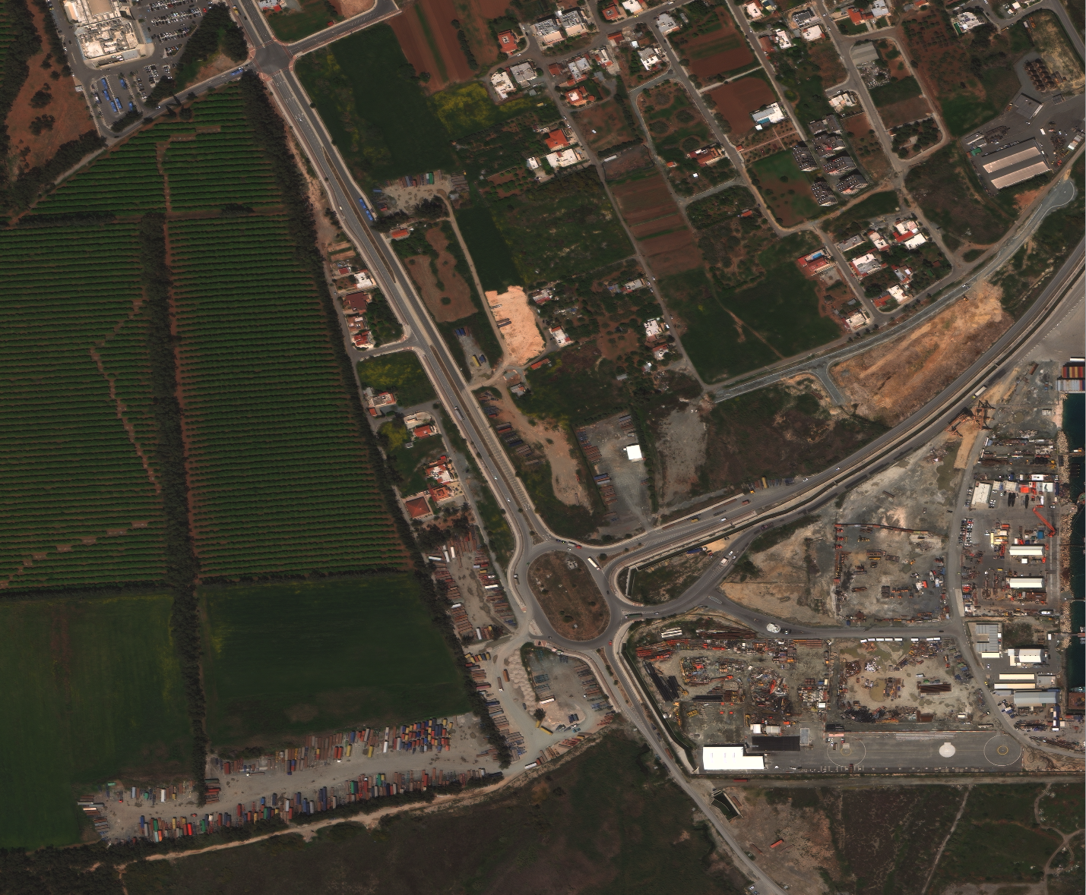
Testing YOLOv3
416
50
416
50

Slide 13
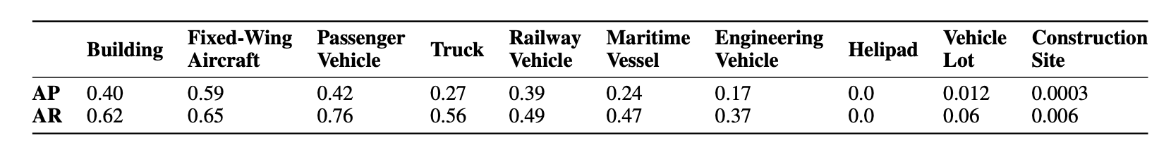
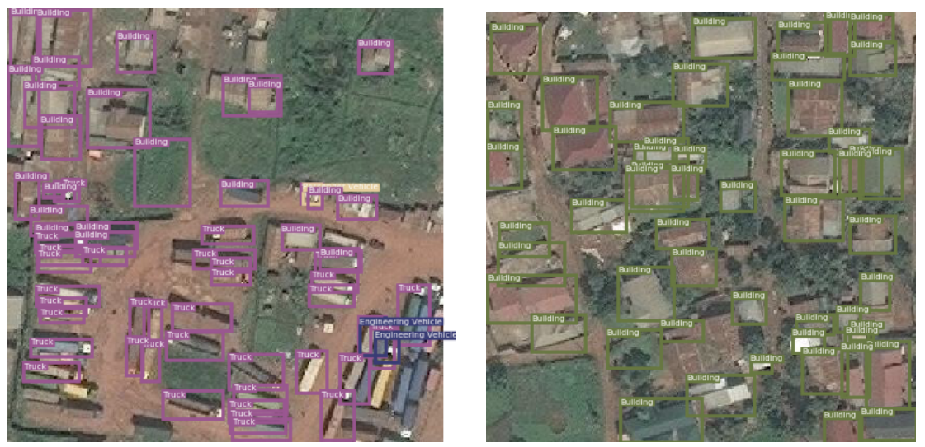
YOLOv3 Results on xView
Average precision and recall on parent level classes (10 classes).
Sample detection results
Notes:
After training the model, we validate their performance on the test set of xView. The detector trained using parent level classes (10 classes) achieves mAP of 0.248 and mAR of 0.42. Table here shows the classwise performance of the parent-level object detector on the test set. Our detector reliably identifies objects, especially at the parent level.
For performance on child level classes, please check our paper.

Slide 14
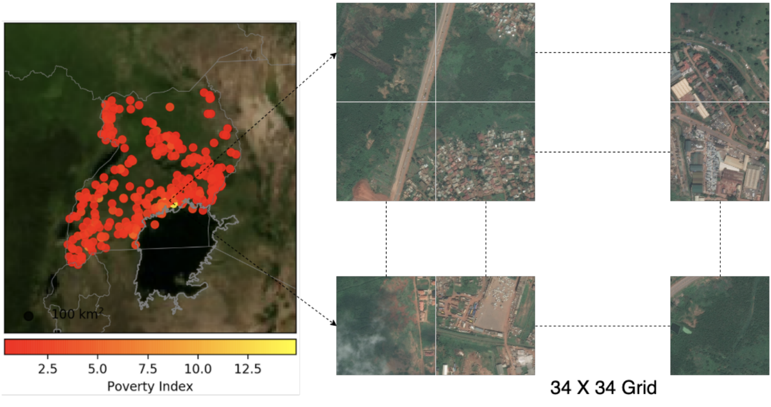
Poverty Prediction Dataset
Our poverty prediction dataset consists of 320 points across Uganda where each points represents a 100 km^2 area.
With high spatial resolution images (0.3-0.5m GSD), each point is represented by 34,000x34,000 pixels.
Each village is also represented by a poverty score collected by a land survey
Notes:
Next we explain our poverty prediction dataset. Basically, each village is represented by a 34x34 grid where each tile in the grid is a 1000x1000px. Each village is also represented by a poverty score that comes from a Living Standards Measurement Study survey conducted in Uganda by the Uganda Bureau of Statistics between 2011 and 2012.

Slide 15
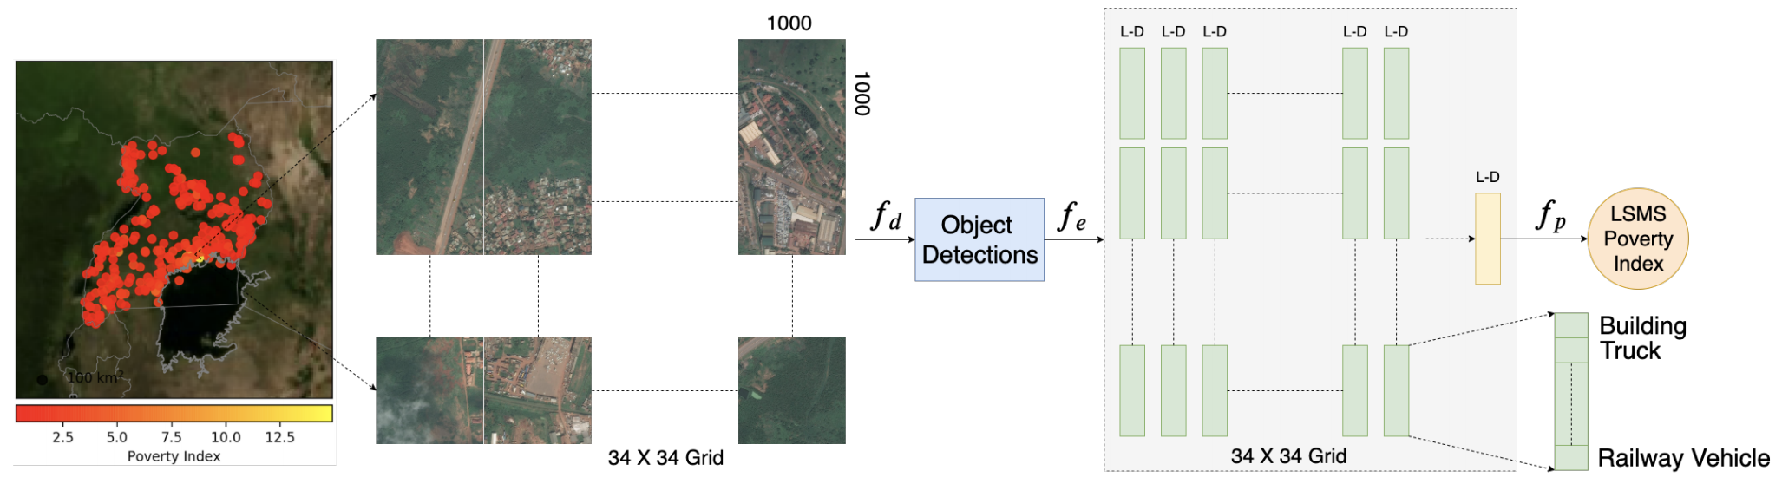
Ayush et al. (IJCAI 2020) - Proposed Approach
We run YOLO-v3 trained on xView on each point from Uganda to estimate object counts.
We then train a regression model using the object counts on the training set of our Uganda dataset.
Notes:
Now we explain the pipeline of the proposed approach in our previous work. We run the trained object detector on 100 km2 neighborhood of a point and obtain the object counts for each xView class as a L-dimensional categorical feature vector. Given the cluster level feature vector, we regress the LSMS poverty score. This approach not only beats previous benchmarks but is also interpretable. We refer viewers to our previous work for more details about interpretability.

Slide 16
Ayush et al. (IJCAI 2020) - Proposed Approach
High Resolution Satellite Images are expensive
Notes:
However, a drawback with this approach is that it requires costly high resolution satellite images. Given these costs, deploying these models at scale using high-resolution imagery quickly becomes cost-prohibitive for most organizations and research teams, inhibiting the broader development and deployment of machine-learning based tools and insights based on these data.

Slide 17
Ayush et al. (IJCAI 2020) - Proposed Approach
Not all tiles contain important economic information like objects
Not required
Notes:
We can see that not all tiles contain important economic information. To address this problem, we propose a reinforcement learning approach that uses coarse, freely-available public imagery to dynamically identify where to acquire costly high-resolution images, prior to conducting an object detection task. This concept leverages publicly available low resolution Sentinel-2 images to sample smaller amount of high-resolution images.

Slide 18
A Reinforcement Learning Approach
Notes:
Now we will show a short animation to give an overview of our proposed reinforcement learning approach.

Slide 19
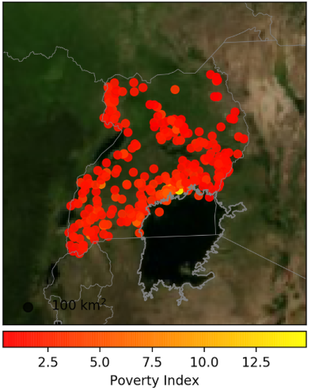
Example Cluster
Notes:
Here we show the map of Uganda with the 320 villages under consideration. We represent each village by a low-resolution satellite image of 1000x1000px from Sentinel-2 satellites. These low-resolution sentinel imagery are freely . Such imagery can be used to get a sense of what regions contain valuable economic information.

Slide 20
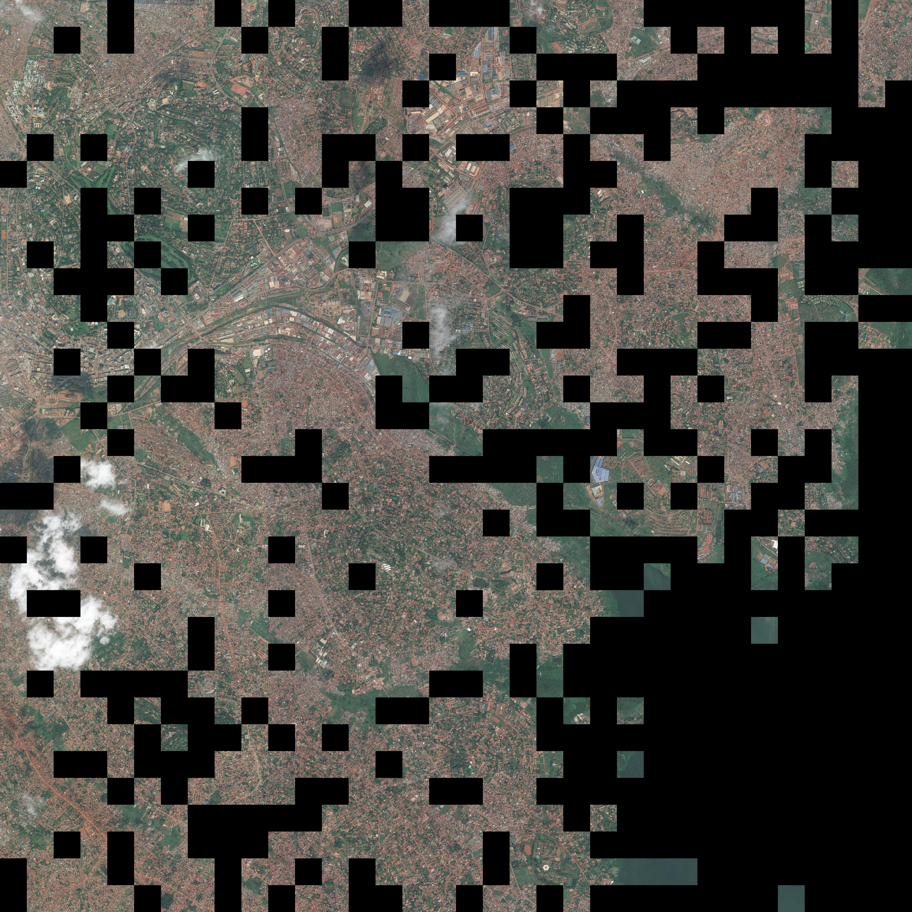
Policy Network
Acquisition of High-Resolution Tiles
Notes:
We pass this low-resolution satellite image through a policy network which outputs an action vector telling us from which regions High resolution tiles should be acquired for running object detection. Here each HR tiles is 1000x1000px but they have been downsized for visualization.

Slide 21
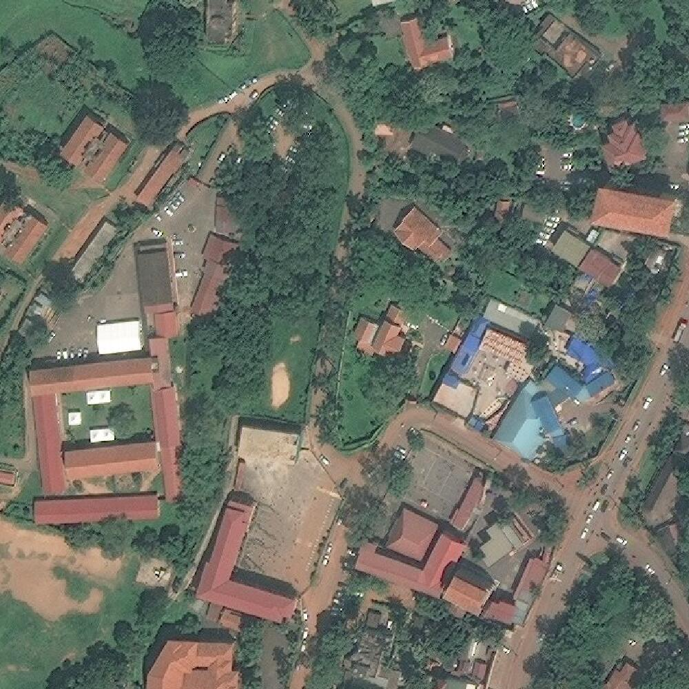
A High-Resolution Tile
Notes:
Here we show a sample HR tile amongst the ones that have been acquired.

Slide 22
Object Detector
Notes:
We run object detection to get classwise objects counts on each each sampled HR tile. Here we show an example.

Slide 23
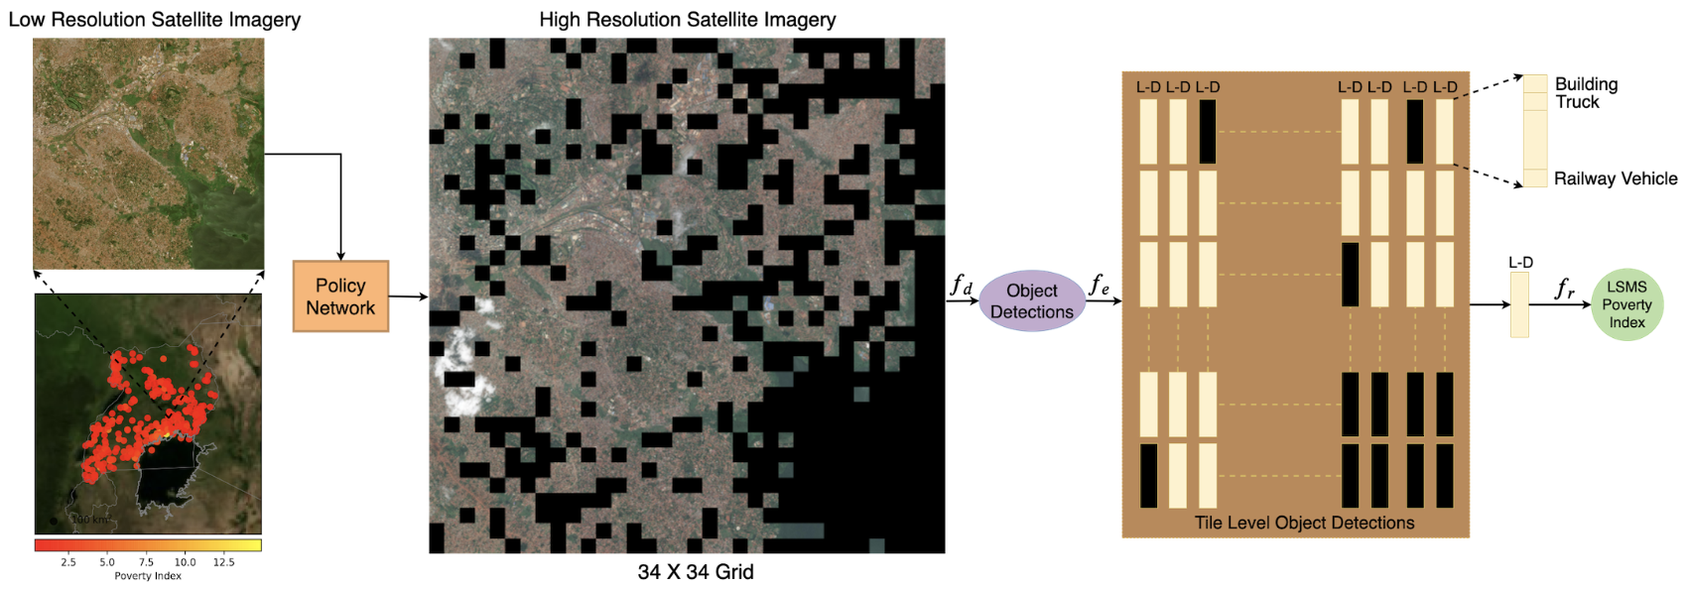
Schematic Overview of the Proposed Approach
Notes:
Here we show the complete Schematic overview of the proposed approach. The Policy Network uses cheaply available Sentinel-2 low-resolution image representing a cluster to output a set of actions representing unique 1000×1000 px high-resolution tiles in the 34×34 grid.Then object detection is performed on the sampled HR tiles (black regions represent dropped tiles) to obtain the corresponding class-wise object counts (L-dimensional vectors). Finally, the classwise object counts vectors corresponding to the acquired HR tiles are added element-wise to get the final feature vector representing the cluster. Our reinforcement learning approach dynamically identifies where to acquire high-resolution images, conditioned on cheap, low-resolution data, before performing object detection, whereas the previous work (Ayush et al. 2020) exhaustively uses all the HR tiles representing a cluster for poverty mapping, making their method expensive and less practical.
This adaptive method is formulated as a two-step episodic Markov Decision Pro-cess (MDP). Inthe first step, we adaptively sample HR tiles and in the sec-ond step, we run them through a pre-trained detector.
The desired outcome from our adaptive strategy is to reduce the image acquisition cost drastically by sampling smaller subset of tiles. Taking this into account, we design a dual reward function that encourages dropping as many subtiles as possible while successfully approximating the classwise object counts.
Using our adaptive method, we obtain an approximate classwise counts vector for a cluster. Following (Ayush et al. 2020), we consider Gradient Boosting Decision Trees as the regression model to estimate the poverty index.
We have N=320 clusters in the survey. We divide the dataset into a 80%-20% train-test split. We train a GBDT model using object counts features(mi) based on all HR tiles of the clusters in the training set. We use the clusters in the training set to train the policy network for adaptive tile selection. The trained policy network is then used to acquire informative HR tiles for each test cluster. The obtained classwise counts vector is then passed through the trained GBDT model to get the poverty score. To evaluate the models, we use Pearson’s r2 to quantify the model performance. Invariance under seperate changes in scale between two variables allows Pearson’s r2 to provide insights into the ability of the model at distinguishing poverty levels. We also report mean squared error (MSE) and Explained Variance (Rosenthal and Rosenthal 2011). Explained variance measures the discrepancy between a model and actual data. Higher explained variance indicates a stronger strength of association thus meaning better predictions.

Slide 24
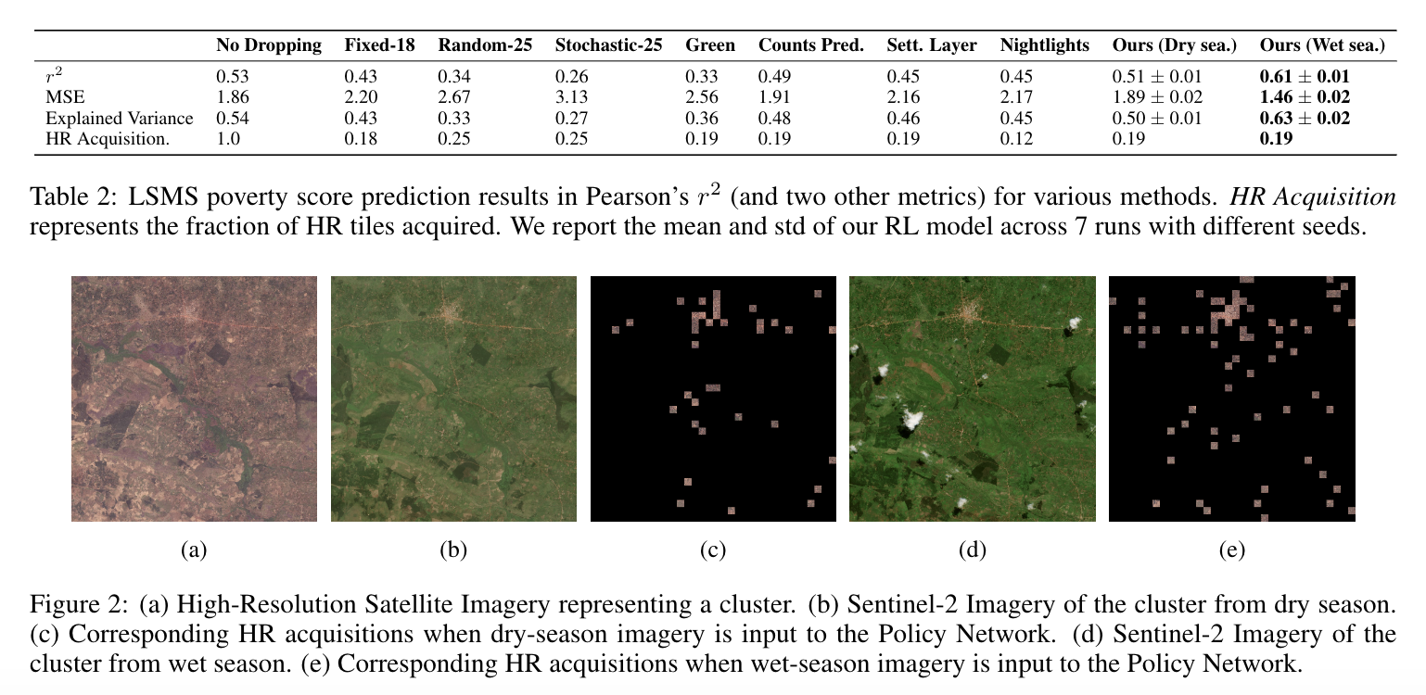
Experimental Results
Notes:
To evaluate the models, we use Pearson’s r2 to quantify the model performance. Invariance under seperate changes in scale between two variables allows Pearson’s r2 to provide insights into the ability of the model at distinguishing poverty levels. We also report mean squared error (MSE) and Explained Variance (Rosenthal and Rosenthal 2011). Explained variance measures the discrepancy between a model and actual data. Higher explained variance indicates a stronger strength of association thus meaning better predictions.
We compare our method with the following:
No Dropping, where we simply use all the HR tiles to get the class-wise object counts features (this is same as (Ayush et al. 2020))
Fixed Policy-X samples X% HR tiles from the center of a cluster
Random Policy-X samples X% HR tiles randomly from a cluster,
Stochastic Policy-X samples X% HR tiles where the survival likelihood of a tile decays w.r.t the euclidean distance from the cluster center
Green Tiles, where we compute the average green channel value for a low-res tile and select bottom K tiles for HR acquisition with least average green channel value, where K is the number of tiles selected by the policy network for a particular cluster
Counts Prediction, where we train a CNN (Resnet-50 backbone) to regress object counts given low-res tile as input. We use this network to select top K HR tiles based on predicted object counts
Settlement Layer, where we select HR tiles based on their population density. We used the HR settlement layer maps and selected top K tiles based on population density, and
Nightlights, where we use Nightlight Images (48×48px) representing the clusters in Uganda and sample only those HR tiles which have non-zero nighttime light intensities.
Additionally, since Sentinel-2 imagery is freely available, we perform a comparative analysis of the effect of season on the ability of the policy network at approximating classwise object counts. We thus acquired two sets of low-resolution imagery, one from dry-season in Uganda and other from wet season corresponding to the survey year. We hypothesize that greenery in low-resolution imagery during wet season will better indicate which patches might contain useful economic information. Presence of greenery during wet season allows the policy network to better identify the informative regions containing objects, compared to when trained with dry season Sentinel-2 imagery as input. Fig. 2 presents an example cluster, where it is seen that training the policy network using wet season imagery better assists the network at sampling informative tiles.
Table 2 shows the results of poverty prediction in Uganda. Our model (wet season) achieves 0.61 r2 and substantially outperforms the published state-of-the-art results (Ayush et al.2020) (0.53r2) while using around 80% fewer HR images.
It is interesting that we can outperform No Dropping method when sampling only20%of HR tiles. Qualitatively ,we observed that it is due to false positives proposed by the object detector on the tiles with no true objects of interest in it. Unfortunately, since we do not have ground truth bounding boxes for Uganda, we can not quantify it. However, our experiments on xView (Table 1) show that our approach achieves higher AP than the No Dropping approach, suggesting our approach is able to remove false positives. In comparison to the baselines relying on external data layers such as settlement and nightlights, our method achieves around 0.16 higher r2. This is because such maps assume that objects are located in the tiles with large night-light intensity or settlement index, however, some objects i.e. trucks, passenger vehicles etc., do not necessarily exist in these areas. Additionally, our approach outperforms the counts prediction model by 0.12 inr2. This might be because the counts predictor is trained to directly regress very noisy object counts thus making it a difficult task.

Slide 25
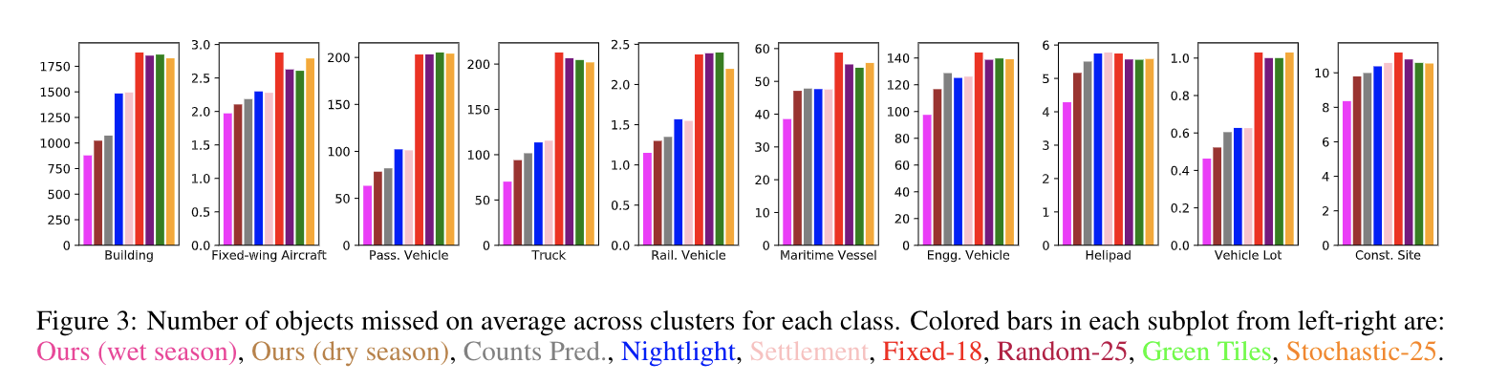
Experimental Results
Notes:
Fig.3 compares the ability of various methods at approximating the classwise object counts. It shows the number of objects missed on an average across clusters for each parent class, where we can see that our method (using wet season imagery) can better approximate the “true object counts” (we use object detector predictions on all the HR tiles as a proxy for true values) compared to baselines and our method (using dry season imagery).

Slide 26
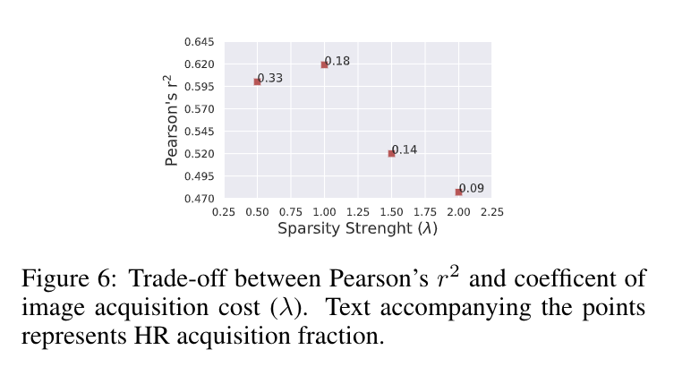
Performance/Sampling Trade-off.
Notes:
We analyze the trade-off between accuracy (regression performance) and HR sampling rate controlled by the hyperparameterλin the reward Eq. 5. We intentionally changeλto quantify the effect on the policy network. As seen in Fig. 6, the policy network samples less HR tiles (a 0.09 fraction) when we increase λ to 2.0 and the r2 goes down to 0.48. On the other hand, when we set λ to 1.0, we get optimal results in terms of r2, while acquiring only a 0.18 fraction of HR imagery.

Slide 27
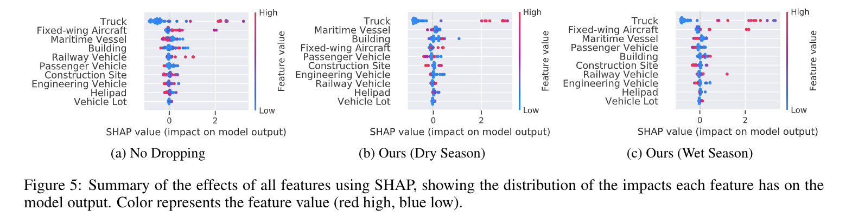
Interpretability
Notes:
An important contribution of (Ayush et al. 2020) was to introduce model interpretability allowing successful application of such methods in many policy domains. They use Tree SHAP, a game theoretic approach to explain the output of tree-based models, to explain the effect of individual features on poverty predictions. Here, we show that in addition to closely approximating the classwise object counts, our method retains the same findings for interpretability as that of (Ayush et al. 2020). Fig. 5 shows the plots of SHAP values of every feature for every cluster for three different methods. The features are sorted by the sum of SHAP value magnitudes over all samples. It can be seen that our method still maintains that #Trucks tends to have a higher impact on the model’s output. We also observe that ordering of features in terms of SHAP values is fairly similar between the No Dropping approach (Ayush et al. 2020) and our method.

Slide 28
Cost Saving
Current pricing for high-resolution (30cm) RGB imagery is 10-20$ per km².
Given that Uganda is 240K km² in land area, creating a poverty map using our method would save roughly $2.9 million if imagery costs $15 per km².
This represents a potentially large cost saving if our approach is scaled at country or continent scale.

Slide 29
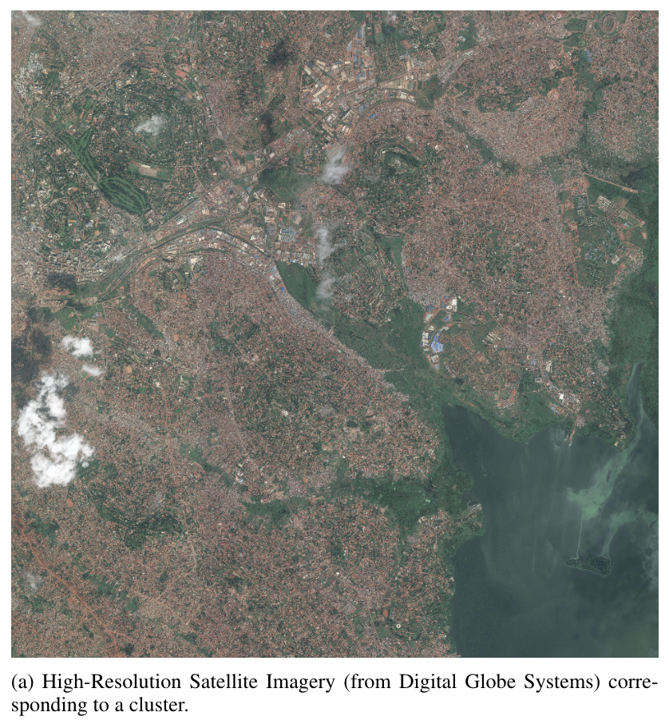
Visualization

Slide 30
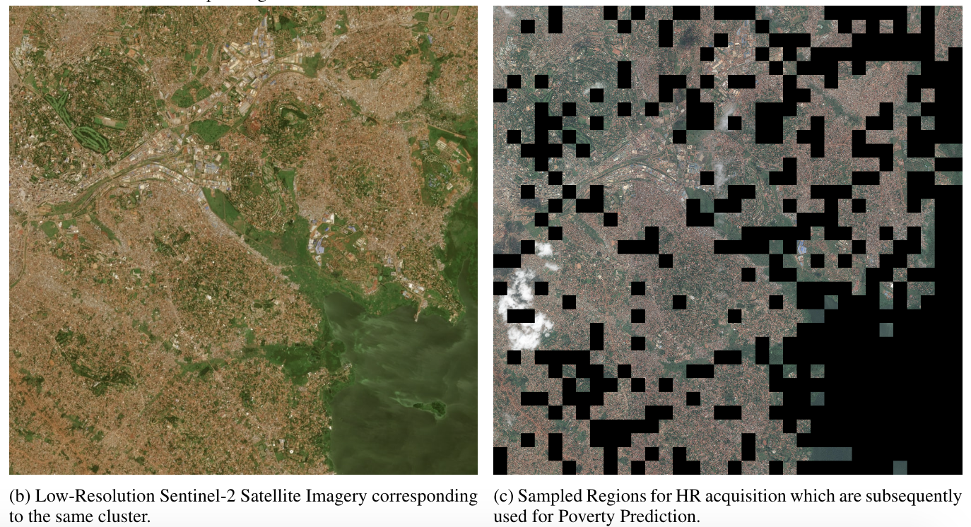
Visualization

Slide 31
Thanks
Notes:
To summarize, In this study, we increase the efficiency of a recent method of predicting consumption expenditure using object counts from high-resolution satellite images. To achieve this, we proposed a novel reinforcement learning setup to condition-ally acquire high-resolution tiles. We designed a cost-aware reward function to reflect real-world constraints – i.e. budget and GPU availability – and then trained a policy network to approximate object counts in a given location as closely as possible given these constraints. We show that our approach reduces the number of high-resolution images needed by 80% while improving downstream poverty estimation performance relative to multiple other approaches, including a method that exhaustively uses all high-resolution images from a location. Future work includes application of our adaptive method to other sustainability-related computer vision tasks using high-resolution images at large scale.

Slide 32
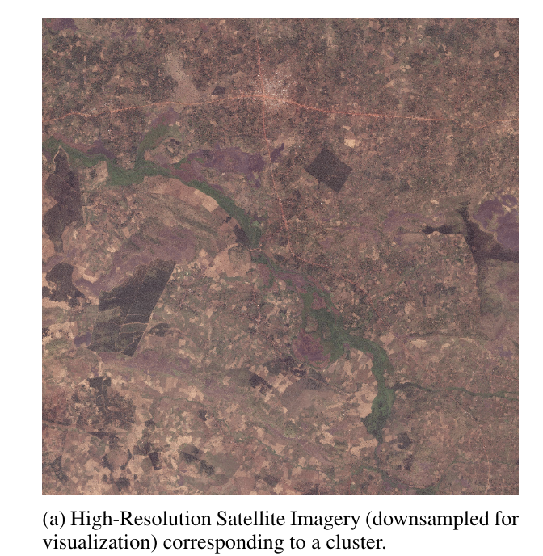
Visualizations
Notes:
Now we show some sample outputs from out adaptive network.

Slide 33
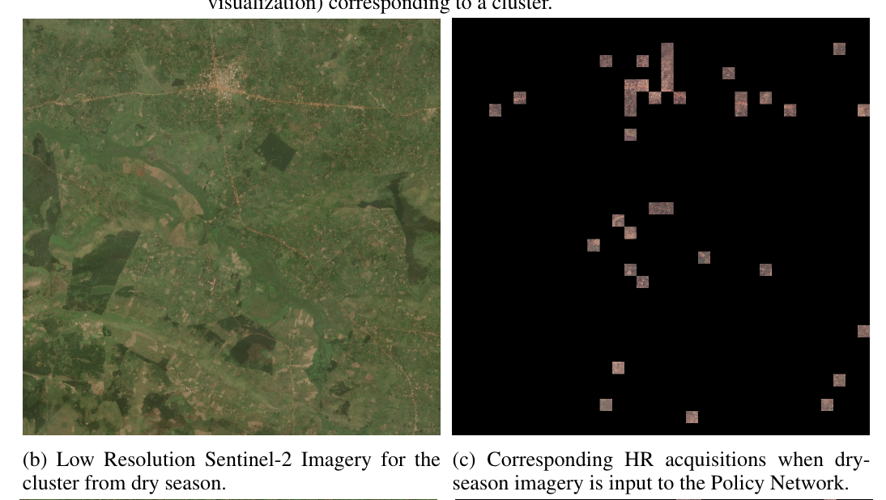
Visualizations

Slide 34
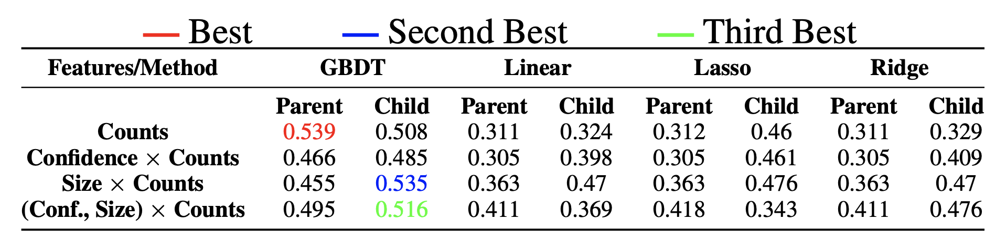
Results
Pearson’s r2 values using features from child and parent level detector.
Method | RGB-CNN | NL-CNN | Jean et al. | Ours
r2 | 0.04 | 0.39 | 0.41 | 0.54
Comparison with baseline and state-of-the-art methods.
Neal Jean, Marshall Burke, Michael Xie, W Matthew Davis, David B Lobell, and Stefano Ermon. Combining satellite imagery and machine learning to predict poverty. Science, 2016.
Notes:
Table here shows the results of LSMS poverty prediction in Uganda. The object detections are obtained using a 0.6 confidence threshold. The best result of 0.539 Pearson’s r2 is obtained using Gradient Boosting Decision Trees trained on parent level Raw object Counts features.
We compare our method with two baselines and a state-of-the-art method. Our model substantially outperforms all three baselines. These performance improvements do not come at the cost of interpretability – rather, our model predictions are much more interpretable than each of these three baselines.

Slide 35
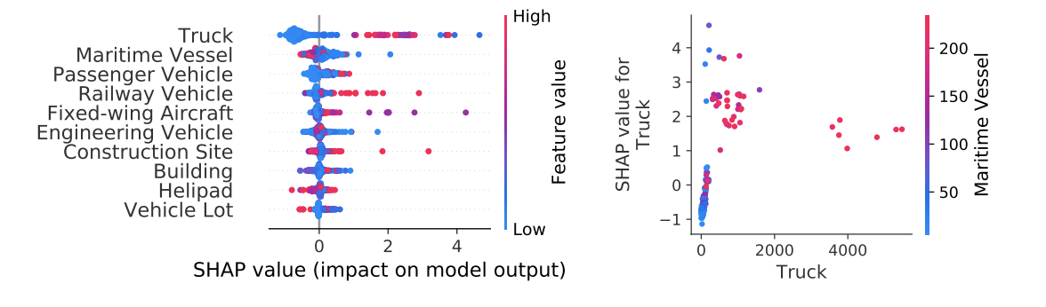
Interpretability
Measuring object class importance for poverty prediction using SHAP method.
*We find that Truck tends to have a high impact on the model’s output followed by Maritime vessels.
Notes:
In this section, we explain the effect of individual features (parent level GBDT model) on poverty score predictions using SHAP. SHAP is a game theoretic approach to explain the output of any machine learning model. We particularly use TreeSHAP which is a variant of SHAP for tree-based machine learning models.
To get an overview of which features are most important for a model we plot the SHAP values of every feature for every sample.
The left plot sorts features by the sum of SHAP value magnitudes over all samples, and uses SHAP values to show the distribution of the impacts each feature has on the model output. The color represents the feature value (red high, blue low). We find that Truck tends to have a high impact on the model’s output. Higher #Trucks pushes the output to a higher value and low #Trucks has a negative impact on the output, thereby lowering the predicted value.

Slide 36
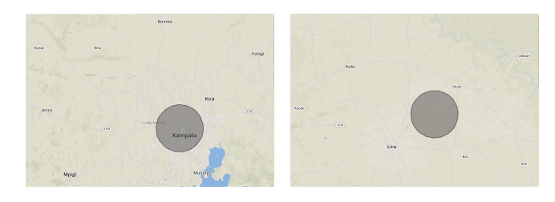
Interpretability
(Left) A region with high wealth level and high truck numbers. (Right) A region with low wealth level and low truck numbers.
*We find that Truck tends to have a high impact on the model’s output followed by Maritime vessels.
Notes:
Here we compare an example region (left) with low poverty level and high #Trucks against a region with high poverty level and low #Trucks. We find that regions with high truck numbers have better road network and transportation connectivity to nearby regions, thereby resulting in better wealth index in those regions as transportation and connectivity play a vital role in the economic growth of a region.

Slide 37
Thanks!
Notes:
In this work, we attempt to predict consumption expenditure from high resolution satellite images. We propose an efficient, explainable, and transferable method that combines object detection and regression. The presence of trucks appears to be particularly useful for measuring local scale poverty in our setting. Our results offer a promising approach for generating interpretable poverty predictions for important livelihood outcomes, even in settings with limited training data.

Slide 38
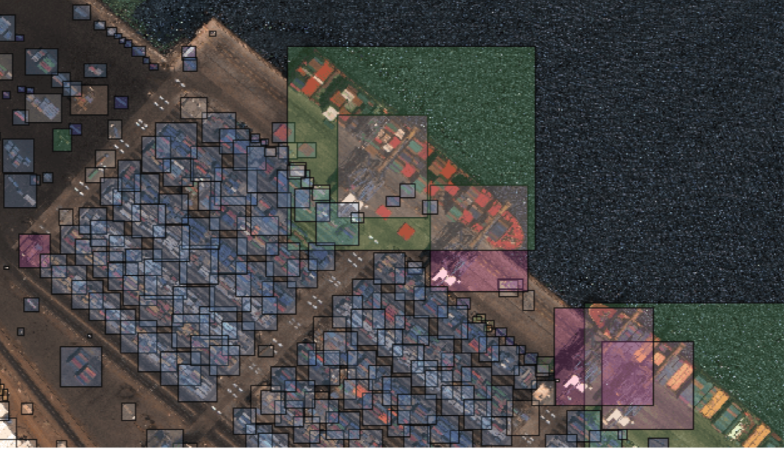
xView - Annotation Examples
Notes:
Here we show some annotated samples from the xview dataset

Slide 39
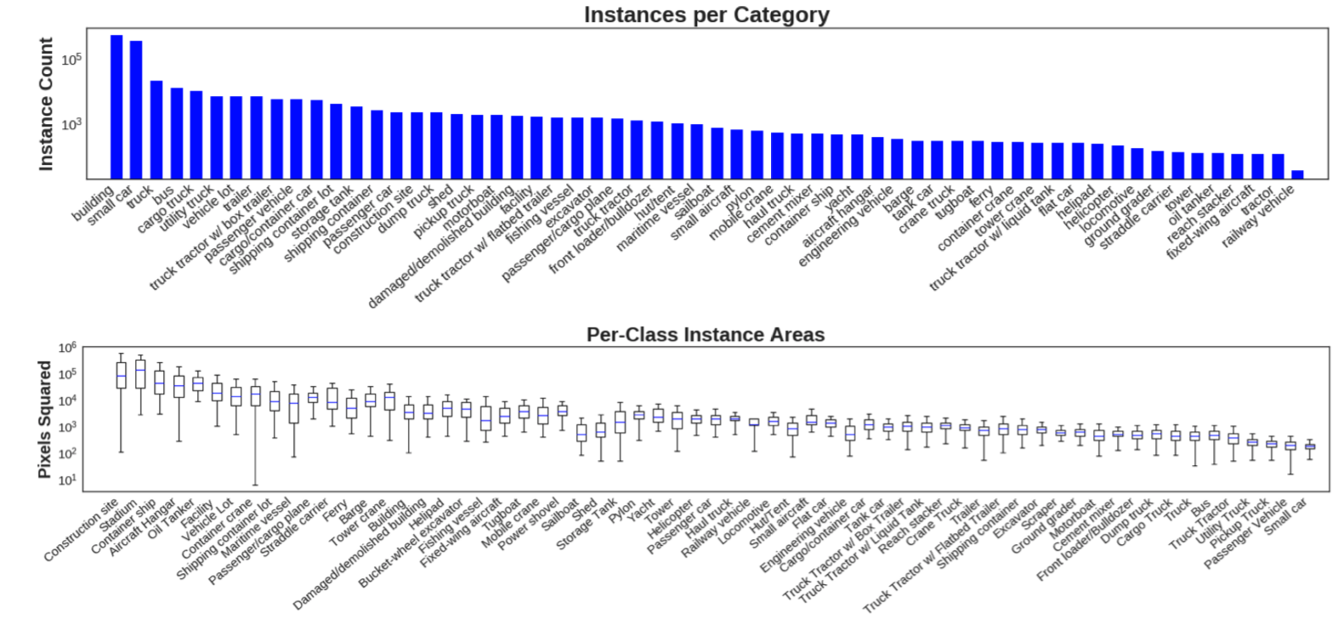
xView - Class Analysis

Slide 40
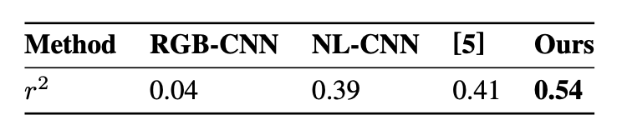
Comparison to Other Models
Comparison with baseline and state-of-the-art methods
[5] Neal Jean, Marshall Burke, Michael Xie, W Matthew Davis, David B Lobell, and Stefano Ermon. Combining satellite imagery and machine learning to predict poverty. Science, 2016.
Notes:
We compare our method with two baselines and a state-of-the-art method. Our model substantially outperforms all three baselines. These performance improvements do not come at the cost of interpretability – rather, our model predictions are much more interpretable than each of these three baselines.

Slide 41
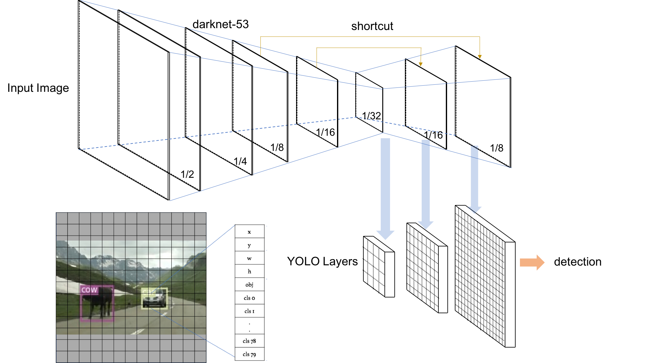
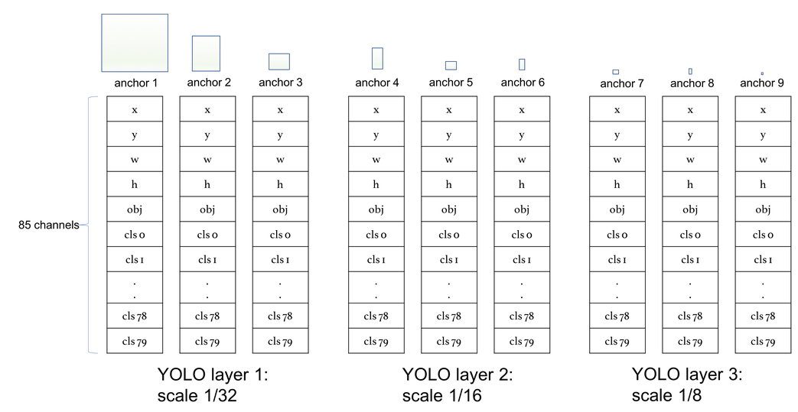
Convolutional Detector - YOLOv3
Large Objects
Small Objects
Mid-size Objects
Notes:
Since we work on very large tiles (∼3000×3000 pixels), we only consider single stage detectors. Considering the trade off between run-time performance and accuracy on small objects, YOLOv3 outperforms other single stage detectors and performs almost on par with RetinaNet but 3.8 × faster on small objects while running significantly faster than two-stage detectors. Therefore, we use YOLOv3 object detector with a DarkNet53 backbone architecture.

